Slide 1
INF10025
Data Management and Analytics
Week 03
Queries with Parameters
Update & Delete queries
Importing / Exporting Data

Slide 2
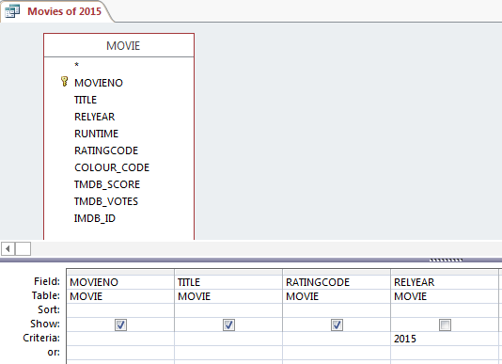
Queries with Parameters
This example creates a query which retrieves all movies with the release year 2015

Slide 3

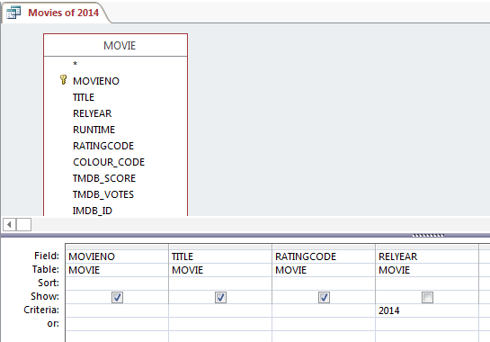
Queries with Parameters
We could create a similar query for movies of 2014.
Eventually you create a number of very similar queries that simply have a different criteria value.
A long list of queries leads to clutter and confusion.

Slide 4
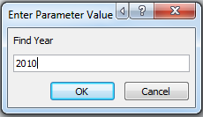
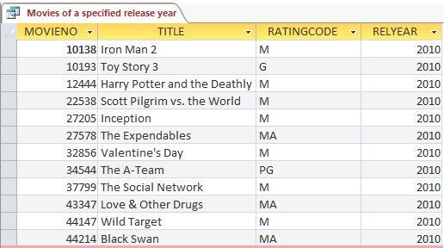
Queries with Parameters
An alternative, is to create a Query Parameter
A parameter is a temporary storage location that is given a name
E.g. Find Year
Then in the criteria for year add this:
= [Find Year]
When you run the query, Access will ask you a question
Finally the correct records are retrieved

Slide 5
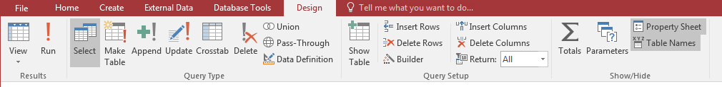
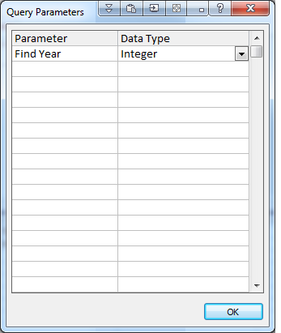
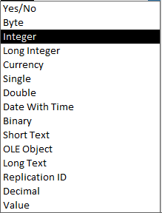
Queries with Parameters
Click on the Parameters icon in the
You create a Parameter Name.
The name may contain spaces.
You specify a data type for the parameter
Generally you would use:
ShortText
Date
Integer – whole number no decimal
Decimal – a number with decimal places

Slide 6
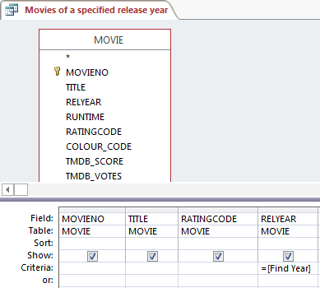
Queries with Parameters
Add the parameter name to the Criteria for the RelYear field and run the query.

Slide 7
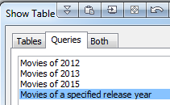
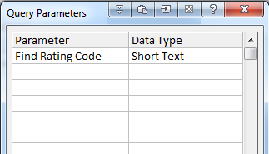
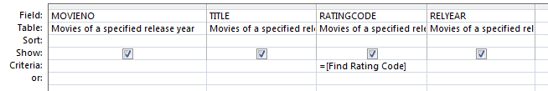
Queries with Parameters
You can combine two queries with parameters
This new query uses Movies of a Specified Rating and Year as its source
It uses a new Parameter named Find Rating Code

Slide 8
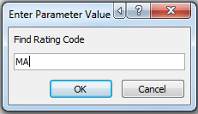
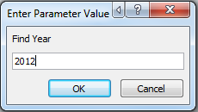
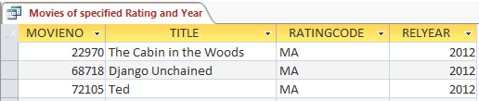
Queries with Parameters
When the query is executed, both parameters are deployed to retrieve the required records

Slide 9
Copying tables
We are about to make a copy of a table.
This is something that you generally want to avoid. Why ?
Imagine a Student table. It stores your id, name, address, phone number…
Now if you make a copy of the table, two tables store your id, name, address, phone…
If you make a change to your phone no, which table should get updated?
Can you guarantee that both tables are updated? No.
Is it possible for the data is two tables to get 'out of synch'? Yes.
Storing the same data in two tables causes Redundant Data.
Data redundancy can lead to:
* multiple versions of the truth
loss of data integrity
However we sometimes want to play or test some Data and we can Simply make a Copy of Table and paste it in Access. Then use this Copied Table to play with the Data

Slide 10
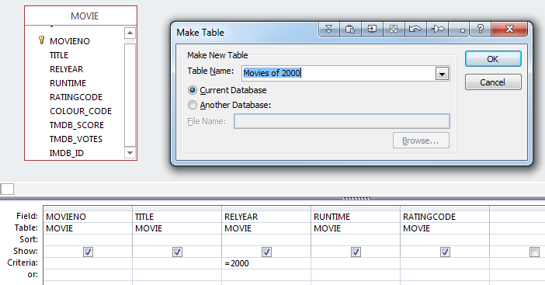
Make Table and Append
Suppose you want to make a copy of the movies of the year 2000 and store them in a separate table.
You can copy rows from the movie table
to a new table named Movies of 2012
You can use the Make Table
icon. When executed via the run icon
a new table is created.
Warning: This causes
Redundant Data!
Useful if you want a new
table for testing purposes
or similar.

Slide 11
Append Query
This option is similar to the Make Table option.
Instead of making a new table, records selected by this query are appended to an existing table.
You have to ensure that the fields on the original table
match the fields that you select in the Append Query.
The Make Table and Append queries should be use sparingly (if at all).
Again, best used for testing purposes only.

Slide 12
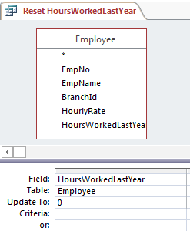
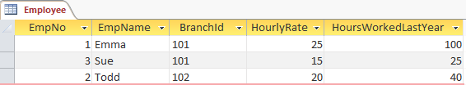
Update Query
An Update Query allows you to change the value of a field(s) for many records at one time.
Example: We can set all employees HoursWorkedLastYear to zero

Slide 13
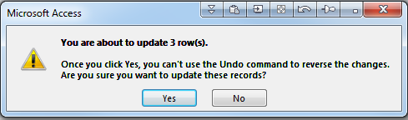
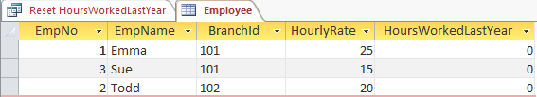
Update Query
When the query is run, Access gives a warning about impeding changes to the table.
(These warnings can be suppressed via Access Settings)
Once you say Yes, the records are changed.

Slide 14
Update Query
Warning:
There is no way to undo an update query. Ctrl Z is useless
Be careful before you execute an Update Query.
E.g. It is possible to update every row in a 10 million row table.
If you specify a criteria incorrectly and do not test you query first, this could have catastrophic results.
It is strongly suggested that you take backups of your data – especially before executing such a query.

Slide 15


Update Query
This example shows how the current Hourly Rate value can be
increased by $2.50 for each of the employees.
The calculation includes the name of the field.

Slide 16
Delete Query
A Delete Query is similar to an Update Query.
Rows are permanently deleted from a table.
These is no undo facility.
Backups of database tables are crucial.

Slide 17
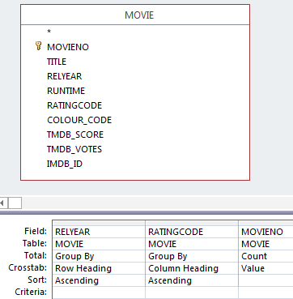
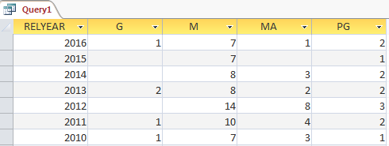
CrossTab Query
A Cross Tab Query is similar to a Pivot Table in Excel.
A crosstab query performs an aggregation (sum, count…) & groups the results by two sets of values - one set of values on the side of the datasheet and the other set of values across the top.

Slide 18
SQL
Almost all Relational Databases use SQL (structured query language) to manipulate objects and data within the database.
This is hidden from you when you use Access because
  Access uses a Graphical User Interface.
  Many non-computer savvy people would have trouble understanding SQL
However, each time you Create a Table or Design a Query, Access is generating SQL behind the scenes.
You can view the SQL that is being generated by Access for a number of actions you perform.
(We will be writing some SQL without help from Access in future weeks)

Slide 19
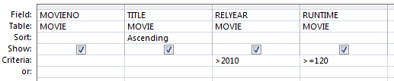


SQL
This is an example of a simple query design screen
The bottom right corner of the screen has an SQL icon.
Click the icon to reveal the SQL statement.

Slide 20
Importing Data
Data often exists prior to the development of a database.
That data often needs to be entered into the Access database tables.
Option 1 : Retype the data
  Costly
  Prone to Errors
  Slow
Option 2 : Import the data using database tools
  No cost (other than creating the process)
  Fast
  No typing errors
  Same process is applied to every record
  Can apply conversion rules
  Can convert data from one datatype to another

Slide 21
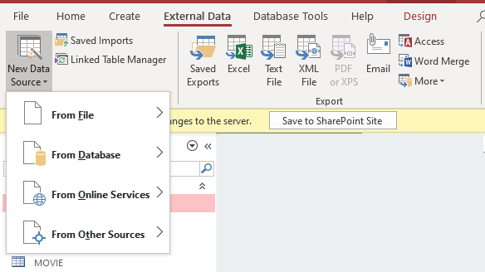
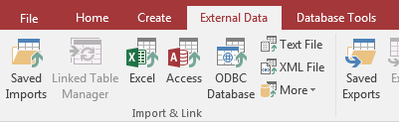
Importing Data
Access can import data from many sources
There are many different source types
Popular types include
  Excel
  Text File
  XML
  Database to Database

Slide 22
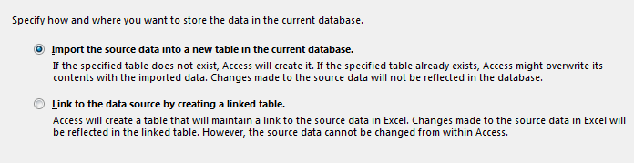
Importing Data
When importing data, you need to determine how you will treat the data
Option 1: Import the data
  Make a copy of the original data.
  The data will be stored in Access Tables.
Option 2: Link to the source data
  There is only one version of the data
  Source Data is maintained by the original application
  Access has a read-only view of the data
Most often used to import data
Used typically when data in Access works in conjunction with data that is continually maintained by another database application.

Slide 23
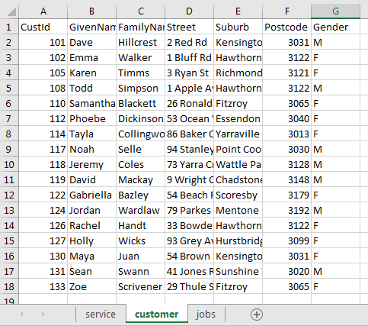
Importing Data from Excel
Rules for importing Excel data.
The data in an Excel spreadsheet must
resemble an Access Datasheet view.
Data has to be placed in
uniform rows and columns.
Data can be located in multiple
worksheets.
Every column must have a heading.

Slide 24
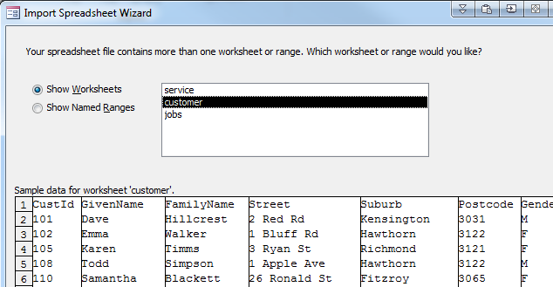
Importing Data from Excel
Access will ask which the worksheet name of where the data is located in

Slide 25
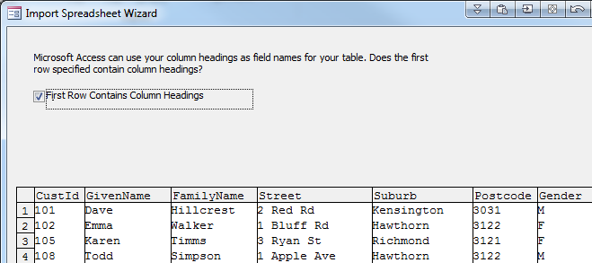
Importing Data from Excel
Specify that the worksheet has Column Heading in row 1.
Otherwise
  Your headings will be treated as field values
  Each field will be given a sequential name such as Field1, Field2, Field3…

Slide 26
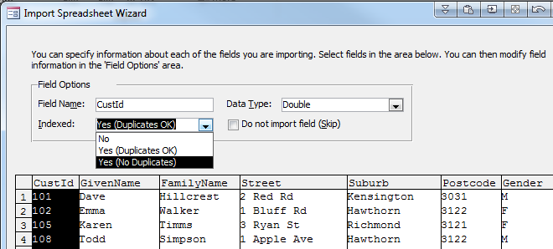
Importing Data from Excel
Specify which fields are Indexed.
The most important field where to specify index requirements is the Primary Key field.

Slide 27
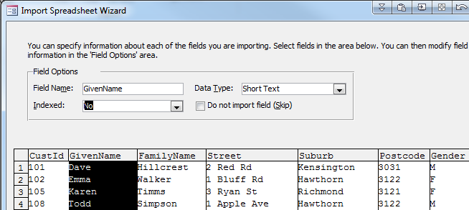
Importing Data from Excel
You can also adjust the name and data type of each field.
Often Text data will need to be converted to a number data type

Slide 28
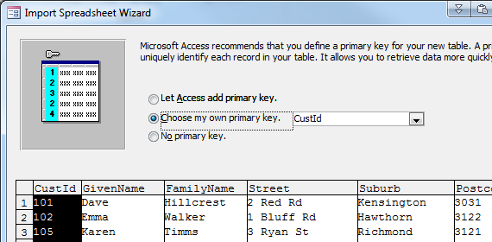
Importing Data from Excel
The final step is to determine the Primary Key
You can allow Access to create an AutoNumber key for you
  This is stored in a new field
Otherwise, select which field already contains Primary Key values

Slide 29
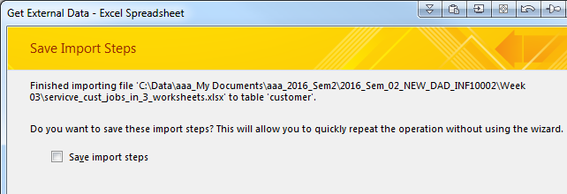
Importing Data from Excel
There is an option to save the Import steps that you just created.
This is useful when:
  You need to import data regularly (every morning, every week …)
  You want someone inexperienced to perform the process
I don't normally save the steps.

Slide 30
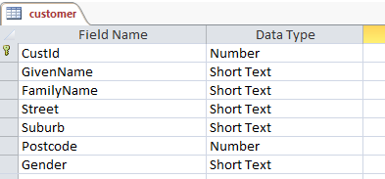
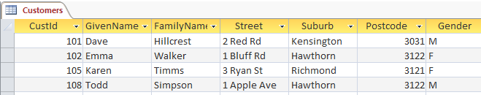
Importing Data from Excel
The data that is successfully imported and saved into a Table.
The table has fields with data types.

Slide 31
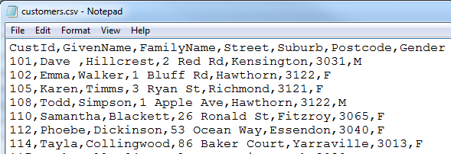
Importing Data from a CSV file
Data is often available in CSV files. CSV stands for Comma Separated Values
This is also sometimes referred to a Delimited File Format, where values are delimited by a character (such as a comma)
Sometimes text-data may be surround by quotes. E.g. 101, "Dave", "Hillcrest", "2 Red Rd"

Slide 32
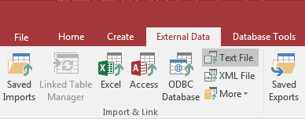
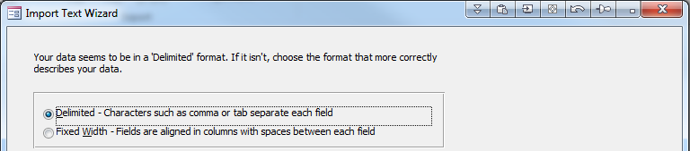
Importing Data from a CSV file
Select the Text File option for CSV files
There are two options for Text files.
  Delimited
  Fixed Width
Choose Delimited for a CSV file

Slide 33
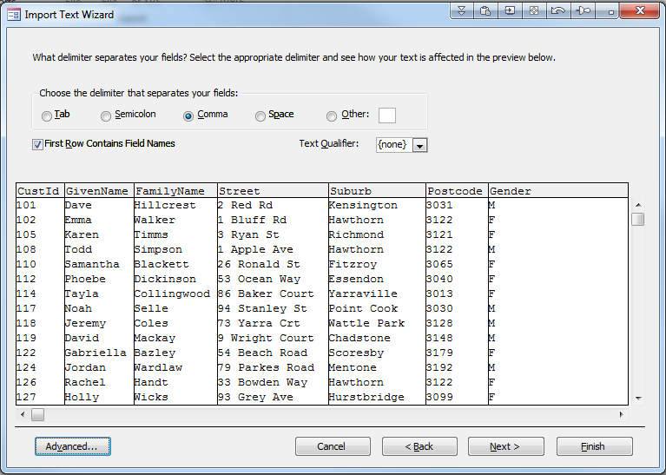
Importing Data from a CSV file
Specify the delimiter character.
  Normally a comma, but it could be another character
Specify that Row 1 contains field names
Specify the text qualifier (e.g. the character surrounding text such as " or ' )

Slide 34
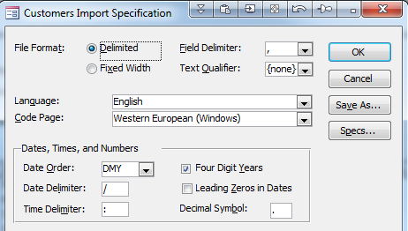
Importing Data from a CSV file
Click on the Advanced button (previous screen) for additional options
These are especially useful when importing dates
These are many commonly used date formats:
Many countries use a comma as a decimal point €123,00:
25/09/2010
09/25/2010
2010/09/25
12-Sep-2010
25-09-2010
09-25-2010
2010-09-25
25/09/10
25/9/2010
2010/9/25
…

Slide 35
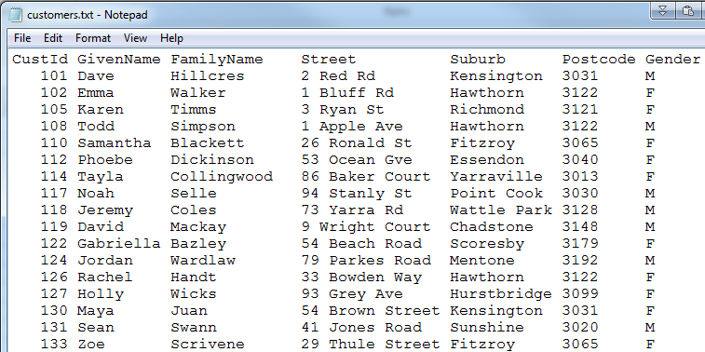
Importing Fixed Width Files
Files are sometimes created as Fixed Width files / Space Delimited files

Slide 36
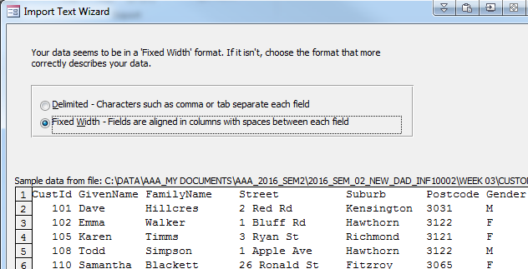
Importing Data
Select the Fixed Width
Option in Access

Slide 37
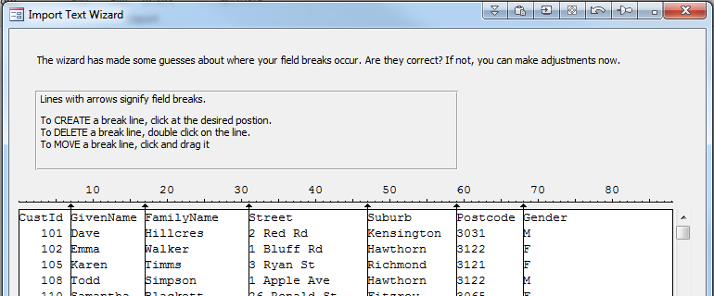
Importing Fixed Width Files
You have to place vertical lines to signify where each field begins.

Slide 38
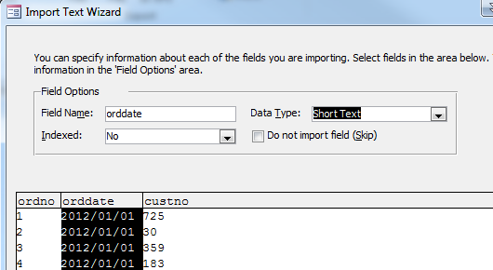
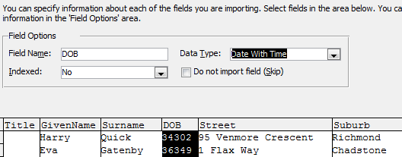
Specifying Field information
When importing data, often Access does not recognize data formats.
Dates are often a problem
As you click on a field, you can modify the Field Name and / or Data Type

Slide 39
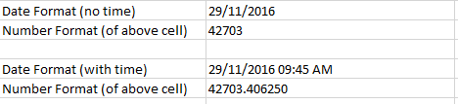
Dates in Excel
You should be aware how Excel stores dates and times
Excel stores dates and times as a sequential number representing the number of days since 1 Jan 1900
The fractional portion of the value stores the time.
This is called a serial date.

Slide 40
Dates in Excel
When you import data from Excel, it may appear that
the values are not dates.
Access will interpret the values correctly

Slide 41
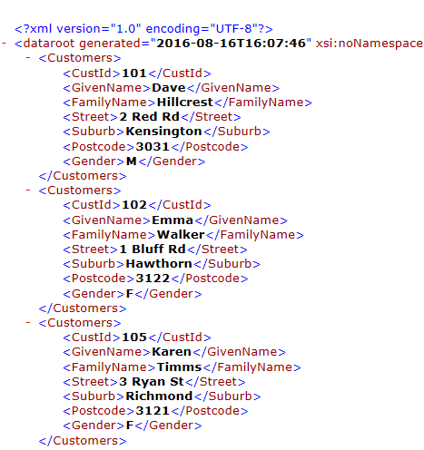
Importing XML files
Access can also import data from
XML files.
Each piece of data is stored between
tag elements
A start tag and an end tag
Tags can have a hierarchy.
This example shows that
the <Customers> tag contains
seven subordinate tags:
<CustId>
<Givenname>
<FamilyName> …

Slide 42
Importance of knowing file formats
An organization typically has
  Many IT systems & Databases
    Accounting systems
    Stock and Inventory systems
    Sales & Ordering systems
    Student Record system
  Data that is exchanged with other organizations
    A list of parts that your organization can order
    A list of VTAC / high-school students that have selected Swinburne University
    in their list of preferred institutions
    A price list
Few (if any) of these systems are integrated.
The only way data can be exchanged is via CSV, Delimited file, Excel file, XML file formats.
Learning how to import / export data via Access in a very useful skill.

